Slide 1
ALPHA PROTOTYPE
Data safety label research tool
Presented by: Elena Korkes and Victoria Hennemann
Notes:
Include context and motivation for project

Slide 2
Research Question…
Are people considering data safety labels prior to installing an app?
Notes:
Tori
Are people considering data safety labels prior to installing an app?
We want to understand people’s understanding of data safety labels,
Create a app that assesses their knowledge of a safety label on the point of downloading

Slide 3

WHAT WE ARE BUILDING?
We are building a full stack Android Application that hosts an automated app based survey to assess user’s knowledge of these data safety labels and the general effectiveness of the labels.

Slide 4
Technical Significance
Automated research tool with varying backend connections
Dynamic generation of survey questions based on data safety labels
Modifying open source web scraper
Notes:
Elena

Slide 5
How is it different?
This is an open area of research. Therefore, not much development has been done. This is why research is a key component of our project. We will be using user feedback to help make our application better and more applicable to specific research goals.
Notes:
The reason its new is because they just started rolling out these labels as a requirements within the last few months

Slide 6
01
Frontend
Design
Java based using Android Studio

Slide 7
Phone 1
Phone 2
Download app 1
Scrape label for app 1
Generate survey for app 1
Collect results for phone 1
Verify both the label and input for phone 1 is stored correctly
Download app 2
Scrape label for app 2
Generate survey for app 2
Collect Results for phone 2
Verify both the label and input for phone 2 is stored correctly
Show that survey is personalized to each device and app
Notes:
Elena - personalization needs to be added, and for each system

Slide 8
Notification System
App Listener for app name (PACKAGE_ADDED intent)
Send package name and user id to Django using droidQuery AJAX function
Send notification using a Broadcast Receiver and Notification Intents
Onclick of notification, redirect user to survey via hosted html

Slide 9
User Interface Design - Survey
Static Questions
Section 1
Knowledge about data safety labels questions using Angular
Section 2
Dynamic Questions
DSL questions updated using droidQuery AJAX function to Django
Section 3
Static Questions
Influence on privacy decisions questions using Angular
Notes:
Data safety label is dynamic in comparison to the other static sections.

Slide 10
02
Backend Components
Web Scraper, Survey Tech, and more!!

Slide 11
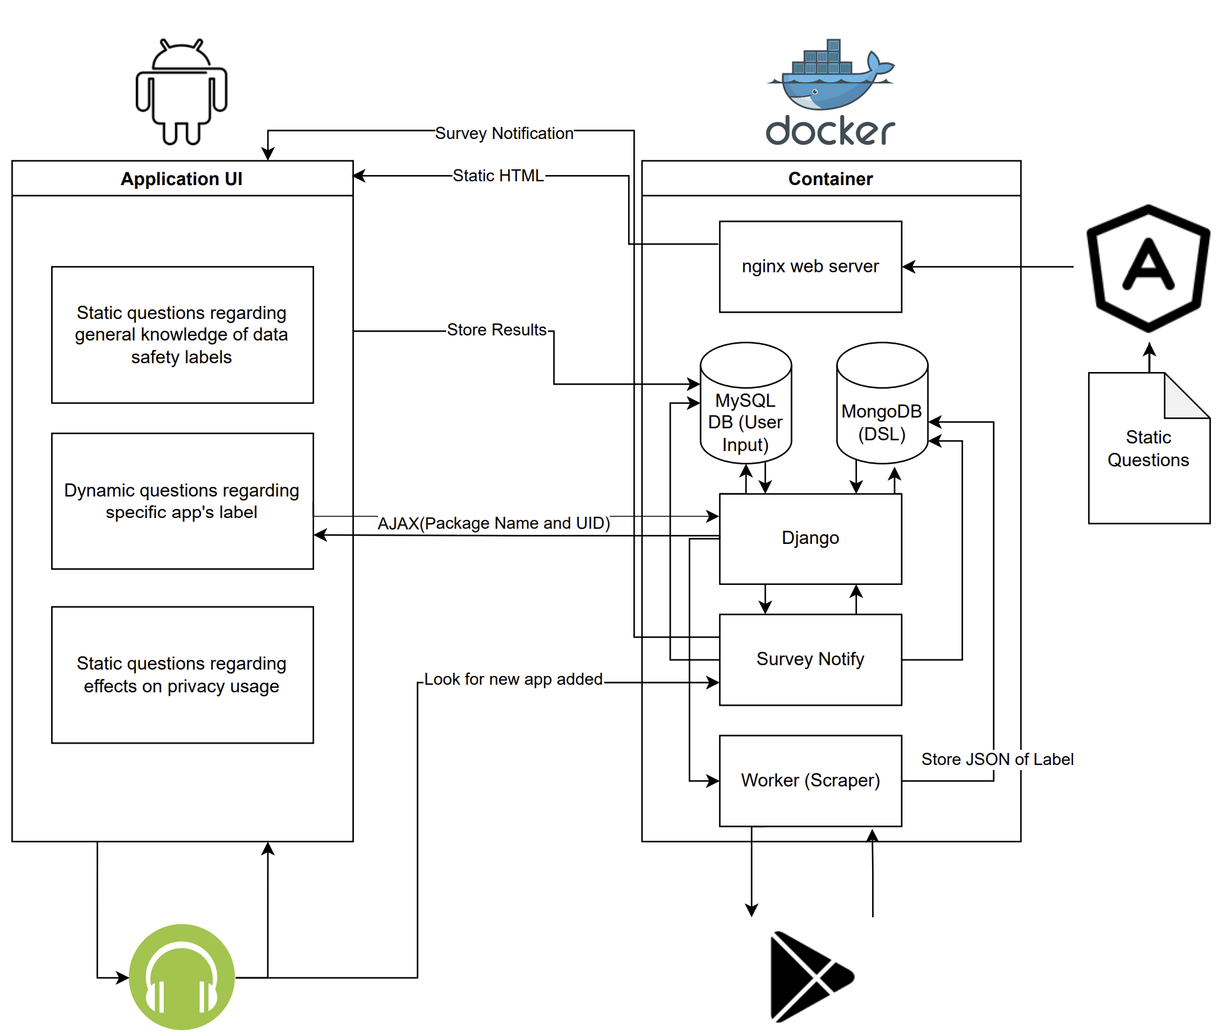
Notes:
Tori

Slide 12
LIVE DEMO

Slide 13





Docker Compose Env
Notes:
Victoria

Slide 14
Web Scraper Details
Notes:
Victoria
Animate that these results get stored back into Django
May need to rescrap for every install

Slide 15
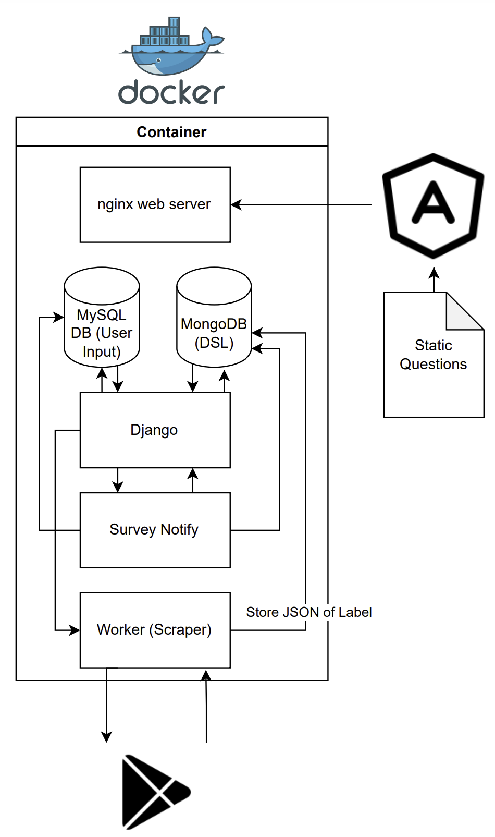
Survey Tech
Static content generated using Angular and NGINX
Modify survey using Django and AJAX to add dynamic questions
Notifier communicates with front end to notify users and store response in MySQL database
Pulls metadata of label for the specific app from MongoDB and sends to Django
Notes:
Mongo db is faster for storing JSON files than a SQL db

Slide 16
How is it different?
This is an open area of research. Therefore, not much development has been done. This is why research is a key component of our project. We will be using user feedback to help make our application better and more applicable to specific research goals.
Notes:
The reason its new is because they just started rolling out these labels as a requirements within the last few months

Slide 17
Further Goals
Have multiple people take the survey at the same time.
Consider Latency
Work on more dynamic implementation
Notes:
Victoria
Survey Tech:
Deciding which questions are the most important
Goals for next semester are to create a more intelligent way of generating the questionnaire (scoring system based on priority)
Android JS Framework:
Our original goal was to write and package the application using the Android JS framework, however, it was unable to provide api calls for the intents that we needed to access.

